Slide 1

Terminology Checker
Kieran Forde, February 2026

Slide 2

Context
➡ | Background - why Terminology Checker exists
➡ | Latest version of Terminology Checker
➡ | Content Design Vision for Terminology

Slide 3
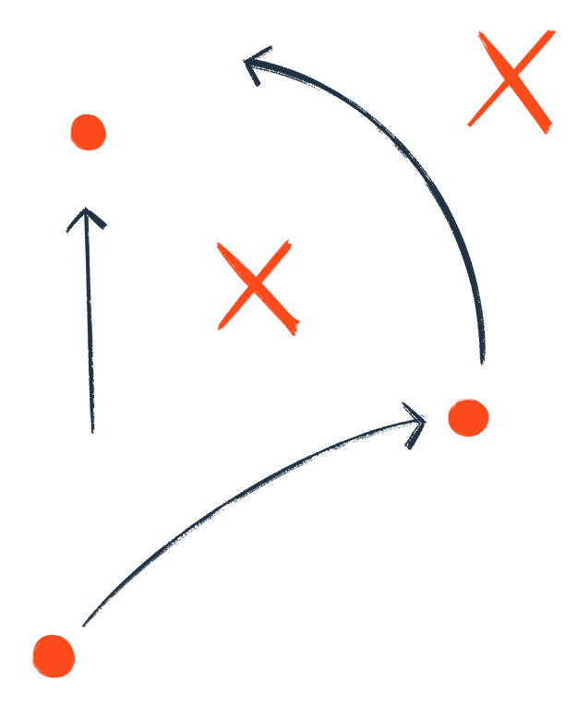

1. Quick recap

Slide 4

TL;DR
What this is: Terminology Checker app scans content strings and compares to Writer docs to find terminology conflicts.
Current state: Hosted in Lovable with Supabase cloud storage. A script fetches .en lyaml files using the Linguine API.
Next challenge: Finding an automated, integrated way to route and fix issues at scale.

Slide 5
Context
Inconsistent terminology hurts usability and trust.
We have ~34,000 critical terminology issues live in the product right now.
Writer helps shape new content, but can’t fix existing content problems.
Terminology Checker finds issues already in prod.

Slide 6


How the app works
I created a script that fetches English translation files using the Linguine API.
Terminology Checker analyses the files and compares them to Writer documentation, identifying issues and conflicts.
The app also uses pattern recognition to detect potential new terms that need to be documented.
Uploading new sets of strings allows us measure “terminology debt” over time

Slide 7
Current flow
Fetching content
Analysing content
Search Sourcegraph for all
en.lyaml files
Grab Linguine cookie session details from API Goggles tool
Upload product strings to Terminology Checker
Upload Writer database to Terminology Checker
Export to csv (example)
Paste cookie details to local file
Saved to Supabase cloud storage
App reports strings that conflict with Writer
App reports strings that contain patterns that look like undocumented terms
Python script visits files in the csv using Linguine
Product strings saved locally
Share csv export with relevant teams/owners

Slide 8
Current flow
Fetching content
Analysing content
Repeat
Fetch new snapshot ↓
Upload
↓
Compare trends
↓
Track issues fixed, added, removed
⟳
Search Sourcegraph for all
en.lyaml files
Grab Linguine cookie session details from API Goggles tool
Upload product strings to Terminology Checker
Upload Writer database to Terminology Checker
Export to csv (example)
Paste cookie details to local file
Saved to Supabase cloud storage
App reports strings that conflict with Writer
App reports strings that contain patterns that look like undocumented terms
Python script visits files in the csv using Linguine
Product strings saved locally
Share csv export with relevant teams/owners

Slide 9
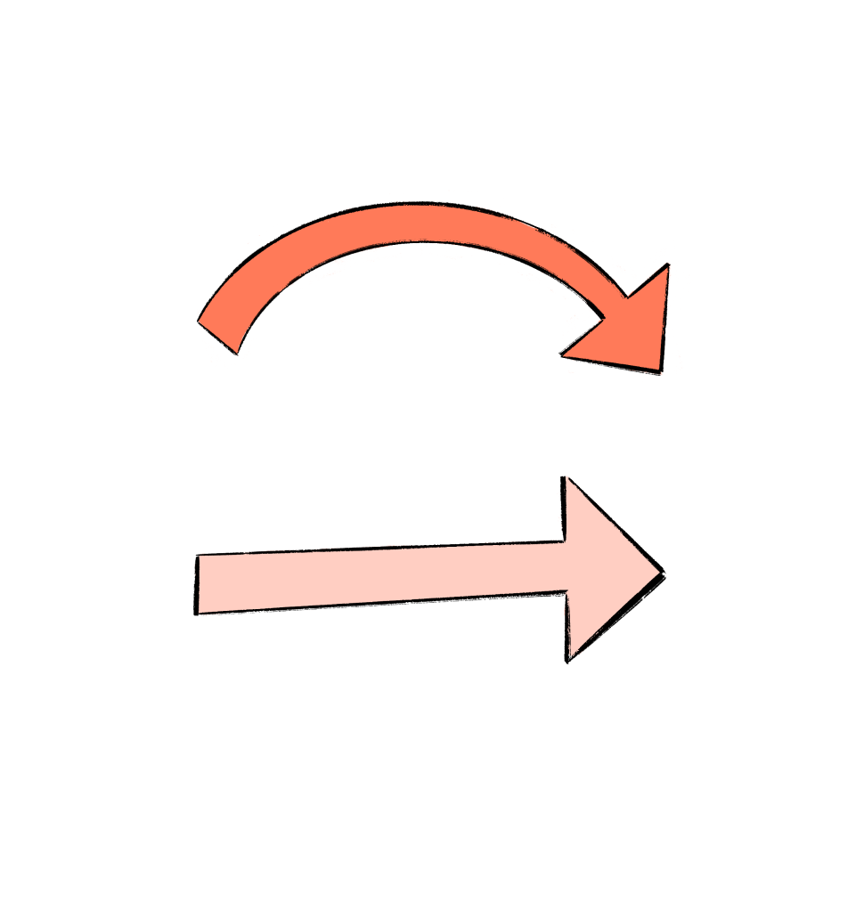
2. Improvements to the app

Slide 10
Updates
December 2025
App running locally
Scanning small batches of strings
Browser-based storage
Sending targeted reports to teams
January 2026
App hosted in Lovable
Scanning snapshots of the whole product*
Cloud-based storage
Ready to scale terminology changes across teams
*Every .en file listed in Sourcegraph and accessible through the Linguine API - there may be missing backend content.

Slide 11

3. What’s next

Slide 12
Paying down debt
Now that we can see all the critical terminology issues across HubSpot, we need a way to fix them! I’d divide terminology issues into 3 categories:
Critical issues - clear cut “wrong’ terms with a simple replacement
e.g. Replace “HubSpot AI” with “Breeze”
Subjective issues - there’s better option, but identifying it might take some thought
e.g. “Try to avoid saying something was successfully done. It's usually redundant and adds complexity.”
Strategic issues - requires collaboration or deeper conceptual work
e.g. A term isn't documented yet or the underlying concept has shifted and the terminology needs rethinking.

Slide 13
Routing issues
We should deal with each category of issue differently:
Critical issues - fix automatically, with minimal review
e.g. generate a PR, Monarch task, or deploy a fix directly
Subjective issues - make it easy to review and propose a fix
e.g. automated Slack notification alerts the relevant designer to the string and guidance; they have the option to generate a PR with a fix, or reject the alert.
Strategic issues - requires collaboration or deeper conceptual work
e.g. automated Slack notification alerts the relevant designer to the string and guidance, with resources to resolve the issue (workshops, advice, Content Design consultancy)

Slide 14

4. Where I need help

Slide 15
Blockers
I’ve made a lot of progress using external tools, but making change happen at scale needs integration with internal systems
I need help identifying the right tools, systems, integrations, and mechanisms to allocate tasks to teams in an appropriate way
I need a better understanding of what infrastructure already exists, and what needs to be built
I’d love to know whether any teams are interested in rebuilding the app on internal infrastructure and helping me solve these scale challenges!

